Slide 1


OnlinePilatesiology.com study On different user behavior
Assignment II
FIT 5145
Lecture: Dr. Pamela Spink
Student name: Maryam Mahmoodi
Student id : 30155843
Notes:
I am Maryam Mahmoodi, I am presenting the OnlinePilatesology study on different user behavior for the second assessment of introduction to data science.

Slide 2
Online Pilatesology company
Services:
Trainers and Clients
Tips
Income Business
Monthly contribution
Market:
Everyone can have access around the world
Purpose of project:
Current performance
Future decision-making
Topics for consideration:
How can we section clients by their internet conduct?
Are there distinct reactions to advertising slogans by region?
What's the greatest scoring site material (how to lower bounce)?
How can we boost the transformation frequency to deposit
Notes:
This project is about online Pilatesology business. They have a subscription cost revenue model and the initiative will explain present business efficiency and prescribe intuitive activities to the client and marketing group.

Slide 3
Project Background
There are two issues to solve:
Do identified factors correlate with transformation behaviour?
Does behaviour differ across areas?
Table 1 Influence diagram components
Notes:
An influence diagram illustrates the design business model. But before that, what issues must be fix?
Problem 1: Do recognized factors relate to transformation behaviour?
Problem 2: Does behaviour differ across areas?
To discover the response, we set the influence diagram printed on the left side of the table, including known and unknown or random factors.

Slide 4
Table 1: diagram components
Notes:
In-depth, we have a roster of recognized factors:
Transfer frequency
Geographic segmentation
Current characteristics during and after the test cycle
To obtain the required result, we need to create several choices mentioned in the third row and
Our opportunity factors in the last line

Slide 5








Project analysis slide 2
Architecture Taxonomy
Big data application provider:
. Application Specialists
. Business consultants
System orchestrator actors:
. Product Management
. Data scientist . Software architect
. Security architect .Business analysis
.Privacy architect .Information Architect
Big data framework provider:
. Amazon web Services
. Cloud provider
Architecture Taxonomy
Data provider actors:
.Users .Marketing team
.Customer care. . Web portal
.Product team .Mobile application
Data consumer:
.Trainers . Applications
.Clients . Researcher
Security and Privacy:
.Security leader
.Corporate Security Officer
Management:
.IT team
.Database engineer
Notes:
In terms of reference architecture classification, this is a custom graph of the OnlinePilatesology data science initiative including system performers, data provider actors, privacy, project manager , AWS services which used for data framework supplier, and so on..

Slide 6
Standard value chain
Data collection
Data Engineering
Data Governance
Data wrangling
Data Analysis
Data Presentation
Operationalization
Notes:
To operationalize data value, we need to handle the quality of each position in the data science cycle.
There are two phases with a sum of 6 measures in iterative phase. Daily data collection, engineering, and governance will be discussed in further presentations. Second, to have a logical knowledge, information must be wrangled, analyzed and submitted in different sizes. Finally, it becomes wisdom and will provide optimum importance.

Slide 7
Analytical level
Descriptive analytics:
Project's first purpose is to obtain understanding into user conduct. The two rows on the right in Table 1(diagram components) show the comprehensive range of variables to be deeply divided to accomplish the Objectives factors
Prescriptive analytics:
On the other side, brand and advertising staff need perspectives into customer behaviours to create several choices on:
Choose the greatest characteristics to include in the brand product
Choose the best segmentation model for both trainers and trainees
The most desired functions to be provided during the test
The most attractive texts to communicate
Notes:
For this project, there are two analytical levels:
Descriptive and Prescriptive

Slide 8
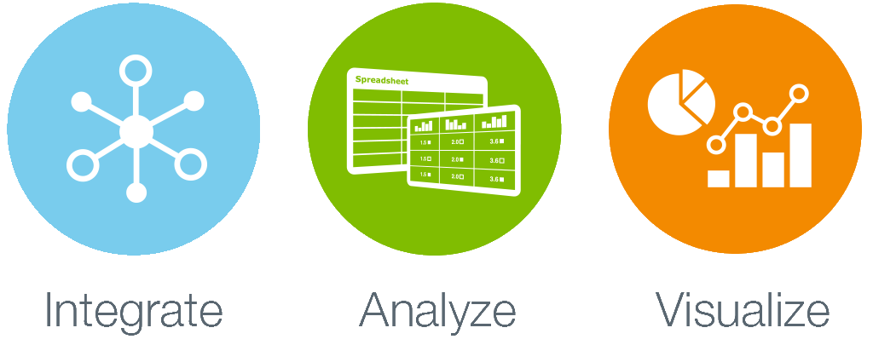
Business Analyst
Role:
Fill up the gap between business and engineering
Data Scientist
Marketing Manager
Role:
Provide information about input and output products
Application area
Data Engineer
Roles
Data wrangling (integration)
Analysis
presentation
Security Architect
Developer
DBA
Roles:
Collection
Engineering
Governance
Application Area according to project’s Value Chain
Notes:
Data science design involves multiple organizations and functions.
Product and advertising group: to provide guidance as specialists on data management, business analyst to bridge the divide between brand and technical group, Data Science to operate with engineering to obtain information to incorporate, analyse and visualize information.
Engineering reporting for information storage, servicing, governance, safety and supply.

Slide 9
LIFE CYCLE
Description and Representation Information
Preservation Planning
Community Watch and Participation
Curate and Preserve
Data management and curation
1) Lifecycle actions
Notes:
Since the business is involved in wellness, information is regarded personal and must be handled safely and legally.
Three different types of operations are needed for data management depending on DCC lifecycle leadership
First, ifecycle activities that must be accomplished independently of any other causes.

Slide 10
Data management and curation
2) Sequential actions
Conceptualise
Create
Evaluate and Select
Consume
Preservation Action
Use and reuse
Transform
Store
Notes:
Second level includes 8 sequential steps to assure data science projects work perfectly.

Slide 11
Data management and curation
Review
Migrate
Dispose
3) Occasional actions
Notes:
And third level is occasional actions which are done once a year to maintain data consistency and honesty, as well as meeting legal and regulatory responsibilities

Slide 12
Data Characteristics
Volume
Manage data handling
Velocity
Analysis of streaming data
Veracity
Uncertainty of data
Variety
Amazon web services
Big data analysis
Different form of data
Descriptive
Structural
Administrative
Notes:
Considering that information has many features, we must schedule and bring action beforehand.
Managing volume and scalability. Online-Pilatesology began as a small business but rising rapidly.
We use AWS information for analytics facilities to prevent future extension hazards.
Data is generated from distinct sources. By using AWS data Lambda, we manage speed and ensure data is always available, searchable and findable.
Data has distinct sizes but for handle this range, we use information metadata to clarify information sizes to promote data recovery.
And, Veracity, which addresses data management ambiguity and involves procedures that give data-based decision-makers greater certainty.

Slide 13
Resources
Coding Software and Language
GitHub
Jira
Confluence
Different sources are used for data science project
Notes:
Different sources are used for data science project.
AWS open source programming environment:
NoSQL and Python.
GitHub
Confluence
Jira

Slide 14
Data Analysis
Current product features
Regression 1
Current available trial
Conversion Behavior
Regression 2
Current reginal segmentation
Regression 3
Current conversion rate
Regression 4
Notes:
For data analysis
The current extract, argues two hypotheses:
Different areas demonstrate the same habits
Known variables correlate with chance variable
To analyse, data scientists have collected associated information and performed regression tests between each recognized variable and conversion rate in each region.
Keeping the recognized variable corrected. In this research will check if recognized factors are correlated with user behaviour. Then the 2nd hypothesis is thus evaluated.

Slide 15
Data Analysis
Conversion behavior region 1
Conversion behavior region 2
Conversion behavior region 4
Conversion behavior region 5
Conversion behavior region 3
Student’s t-test
Notes:
In the last step, run a student t-test to match each region's behaviour with other areas to see if their behaviour was significantly distinct.

